Slide 1

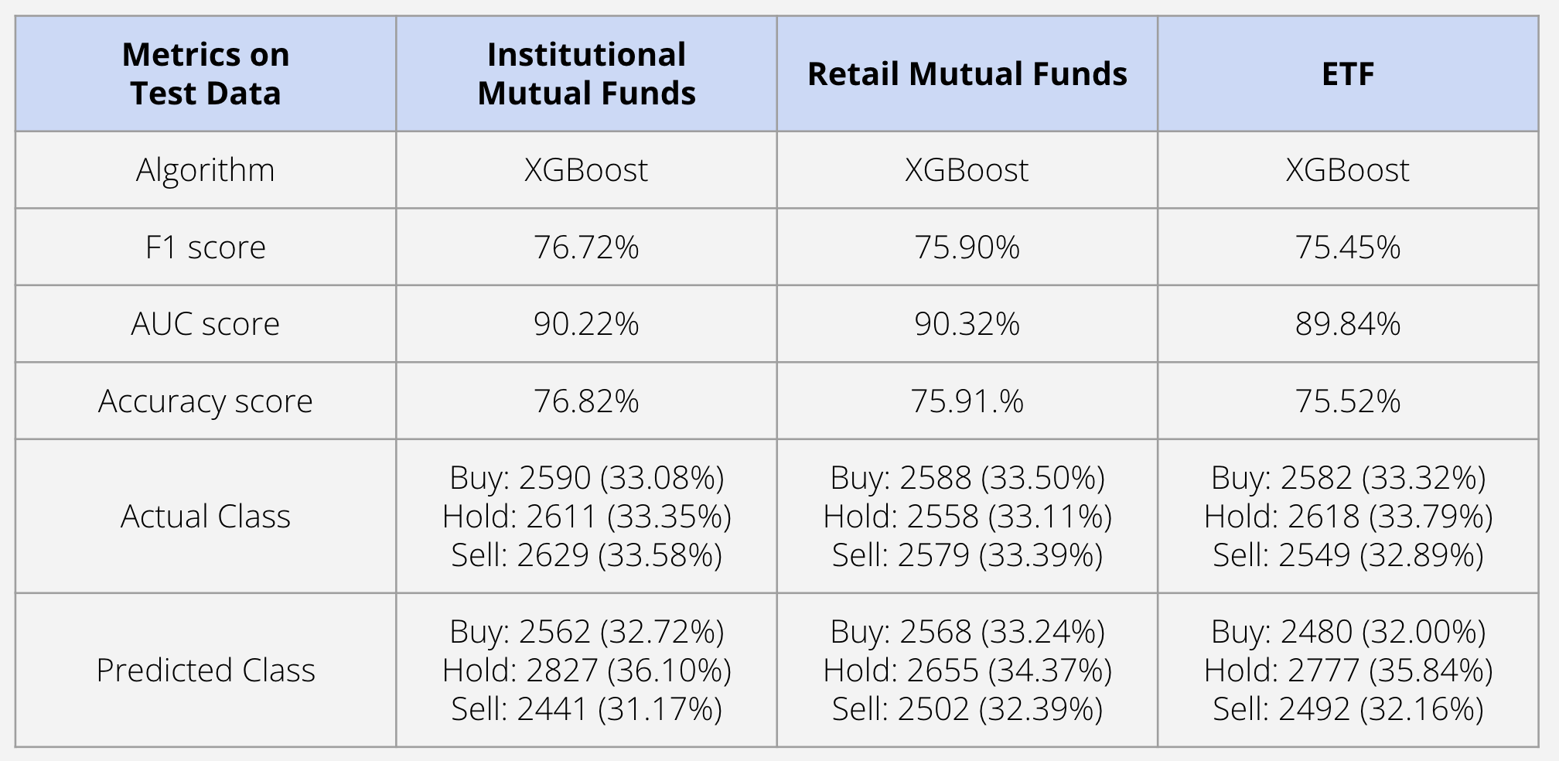
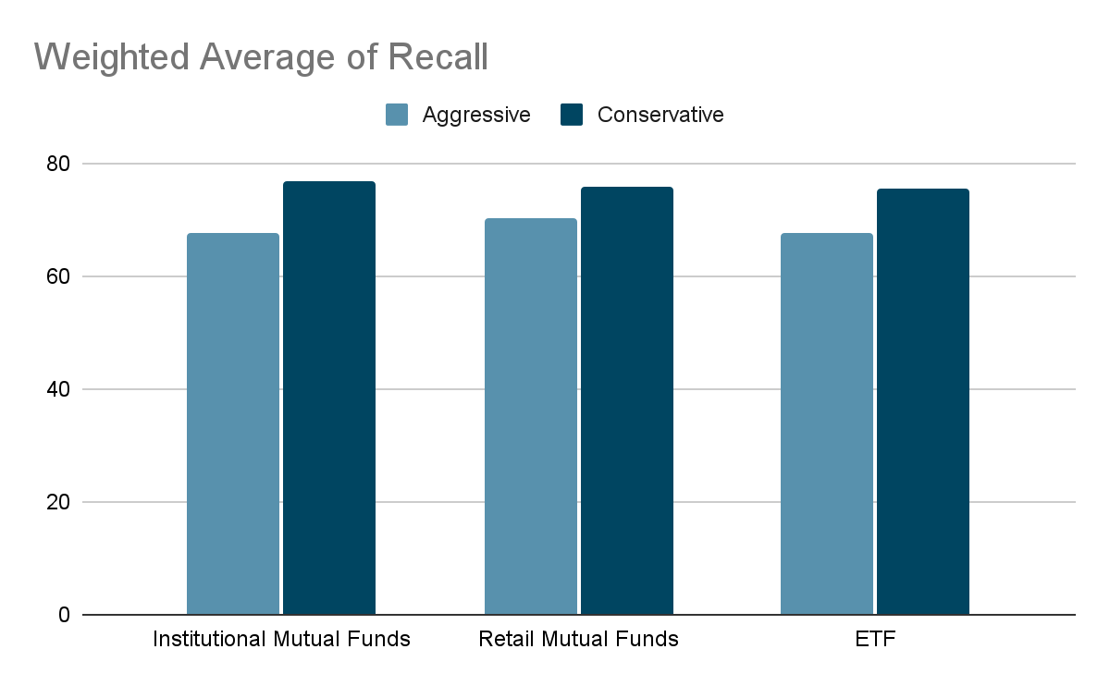
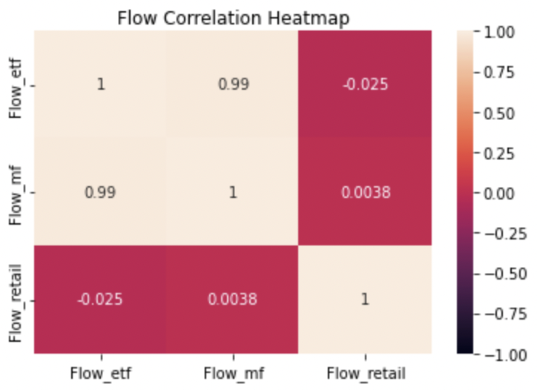
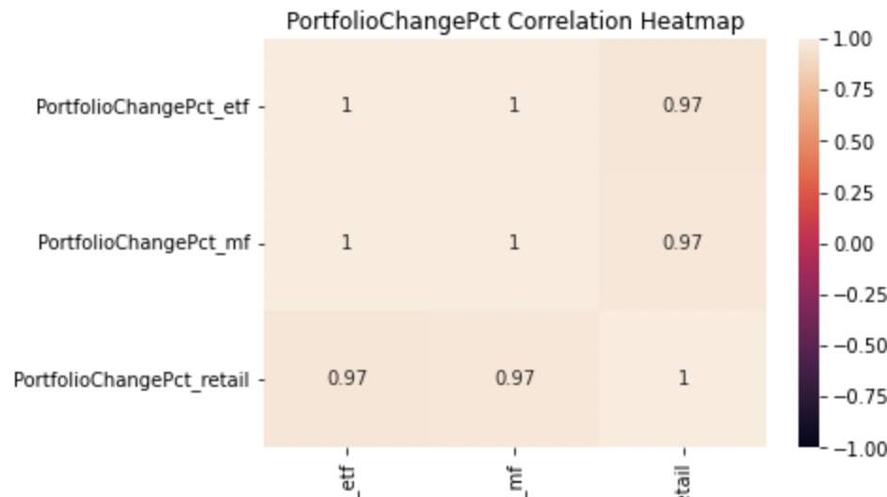
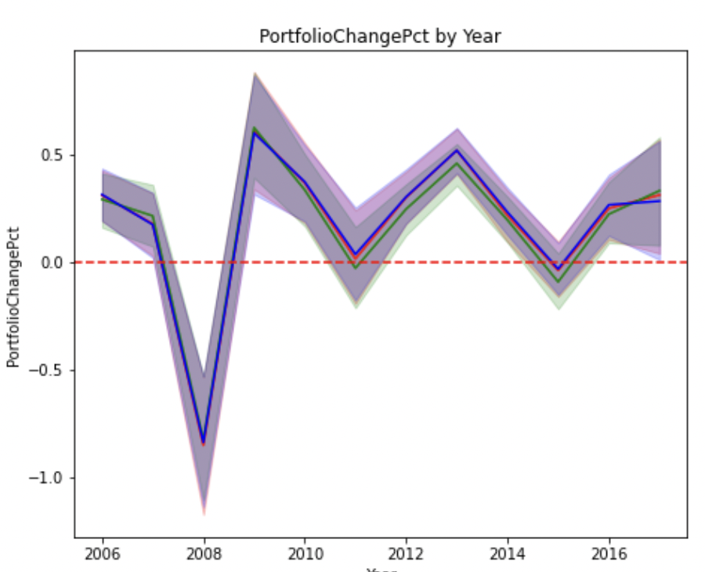
Spinnaker Analytics
Modeling for a Tradable Signal
Team B5: Lujain Alqassar, Yesol Lee, Ta-Wei Wang, Shrey Sood, Yilun Wang
Introduction
Dataset Overview
Methodology
Final Model
Looking into investing in stocks, and the stock market in general, we can see that it is a very volatile and unpredictable area to get into.
As is said in many investment advice: “past performance is not an indicator of future success.” Even though it is hard to indicate future performance, this could not stop us from trying to find a signal to help indicate what future actions we can take to optimize stock buying and selling.
Our client, Spinnaker Analytics, is a high profile software company that provides professional services to businesses and has requested us to help them in finding a possible solution to a question they want answered.
Time Duration:
Jan 4th, 2006 - Feb 1st, 2017
579 weeks
Three datasets:
Institutional Mutual Fund Holdings:
10k observations
Retail Mutual Fund Holdings:
11k observations
ETF:
11k observations
Intersected rows:
10k rows
Columns:
ReportDate
AssetClass
Flow
Linear Regression Models
OLS testing MSE: 9.697
Ridge testing MSE: 9.697
Lasso testing MSE: 9.623
Logistic Regression Model
Aggressive: F1 70.45 / AUC 70.04
Conservative: F1 57.20 / AUC 62.66
Decision Tree Model
Aggressive: F1 89.84 / AUC 67.00
Conservative: F1 59.99 / AUC 70.89
Random Forest Model
Aggressive: F1 89.74 / AUC 69.12
Conservative: F1 62.10 / AUC 71.36
LSTM architectured Neural Network Model
Average validation MSE: 5.803
Time Series Model:
Best predictions: AssetsEnd and Flow Pct
XGBoost Model
Our team chose classification models using the XGBoost algorithm for the final models. These models use Asset Class indicators, Flow, Flow pct, Assets End to predict the next week's tradable signal.
We had two approaches, aggressive and conservative, to define the tradable signals. The aggressive approach uses 5% of Portfolio Change Pct as a cutoff. The conservative one uses 3%. In both approaches, Buy for positive, Sell for negative, and the rest means Hold.
The original data was highly imbalanced and about 93% of data points were in the Hold class. To mitigate risk from imbalanced data, we oversampled the dataset and made classes equally distributed, then train the tuned models on resampled datasets.
After training the model on the train data, we evaluated the model on test data and calculated the metrics, F1 score, AUC score, and Accuracy.
Our team also focused on Recall, also known as true positive rate, our confidence level of models. Once an investment decision is made, it is difficult to take back and a false decision might result in a huge loss for the clients. So our team concluded high recall, and low false-negative should be a measurement of models' confidence.
FlowPct
AssetsEnd
PortfolioChangePct
Business Problem
Exploratory Data Analysis
Finding a tradable signal in all of the datasets that can be used for determining whether to buy or sell a stock portfolio in the future.
In doing so, we want to minimize the any possible risk and maximize the profit of the investments for possible clients.
The heatmap below shows Institutional Mutual Fund and ETF have a higher correlation. FlowPct is similar to Flow since it’s just percentages of it.
The second heatmap shows that there is very high correlation between AssetEnd and PortfolioChangePct across the three datasets.
The lineplot shows for every year, the PortfolioChangePct correlates across all three datasets
Addition Information:
By Year
Cash flow for ETF and Institutional Mutual Funds increased while Retail Mutual Fund decreased.
AssetEnd for all three categories increased
By Month
Cash Flow for all three categories increased
History
PortfolioChangePct had 2 huge dips at 2008 and 2014 due to the economic crisis
Limitations
Conclusion
Not having more subdivided tradable signals, such as strong buy - moderate buy - weak buy, and so on
Not enough predictive variables in our classification models to better predict whether to sell or buy.
Time Series does not give enough insights in achieving our objective.
After resampling, the recall rate increased due to a more average distribution of 35% for all three buying, selling, and holding signals. We are able to achieve an average F1 score of 76.02% and an AUC score of 90.12%.
However, the numbers from the models are all from historical records. Since we are dealing with investments that are volatile, a possible solution to improving performance is to include more financial characteristics.

